Slide 1
UNIVERSITA’ DEGLI STUDI DI MODENA E REGGIO EMILIA DIPARTIMENTO DI INGEGNERIA DELL’INFORMAZIONE
CORSO DI LAUREA IN INGEGNERIA INFORMATICA
Analysis and Development
of Functions in REST Logic:
Application to the «DataView» Web App
RELATORE:
CANDIDATO:
Char.mo Prof. Sonia Bergamaschi
Alberto Rigenti
ANNO ACCADEMICO 2009/2010

Slide 2

VIEWER
Web Application
REST Architecture
DataView Extender

Slide 3


REST Architecture
Identified by a URL
Web Service = RESOURCE
STATE-LESS
CACHE
CLIENT-SERVER
Example = http://servername/resource_name
Representational
State
Transfer
WORLD WIDE WEB
request
response
SERVER = Data Storage
CLIENT = User Interface

Slide 4


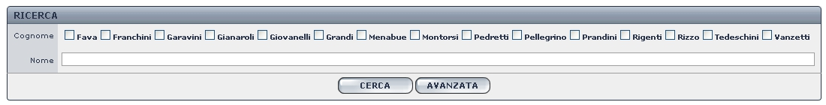
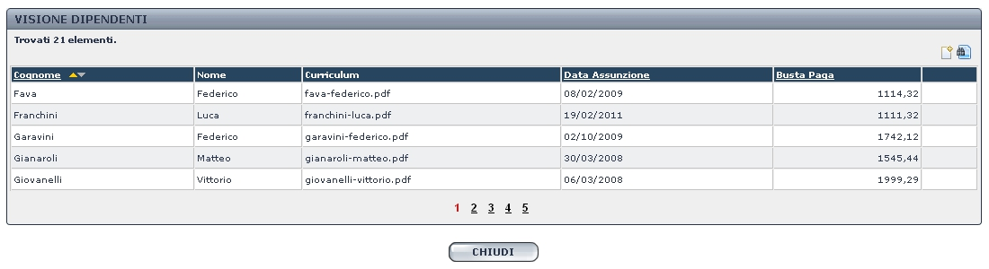


DataView
DataSource
Data View
QUERY SQL
OUTPUT
PARAMETER
Ing. Roberto Pellegrino
QUERY
ACTIONS
INPUT
PARAMETER
DBMS

Slide 5





VIEWER
Request for a Data View Definition
Created to Replace the Default viewer
Entirely Developed
by Myself
VIEWER CLIENT
Stand-Alone
DATA SOURCE
TMP FOLDER
Request for the Result Set
CACHE
VIEWER SERVER
DATAVIEW SERVER

Slide 6

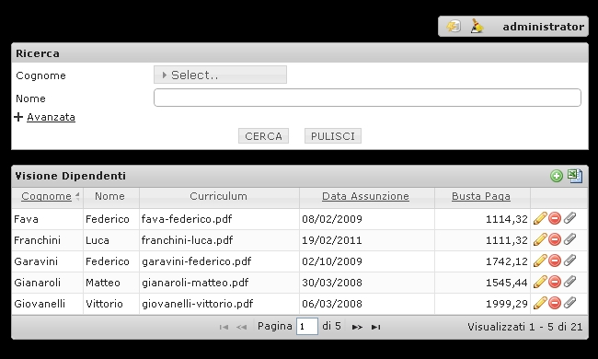
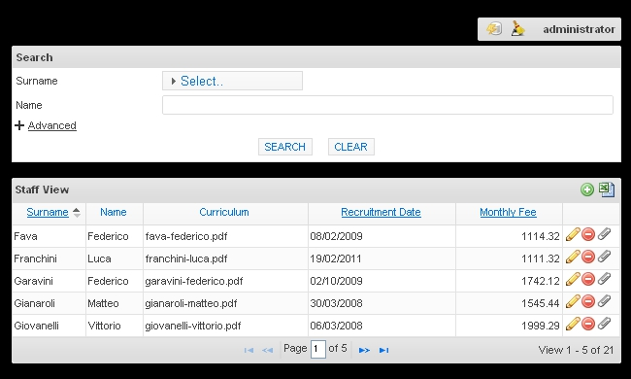
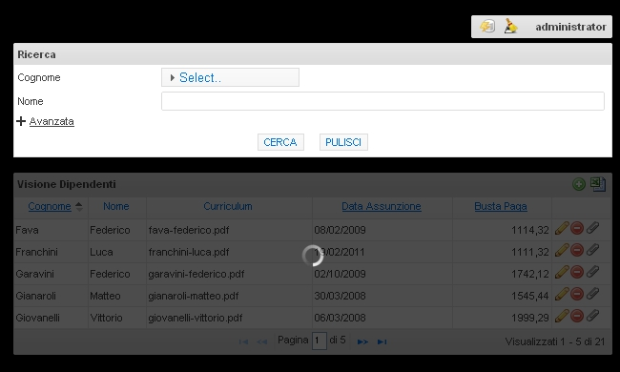
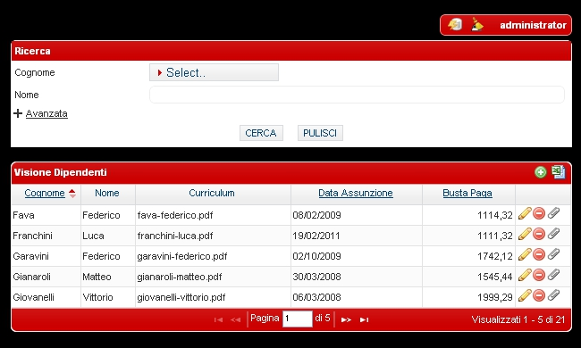
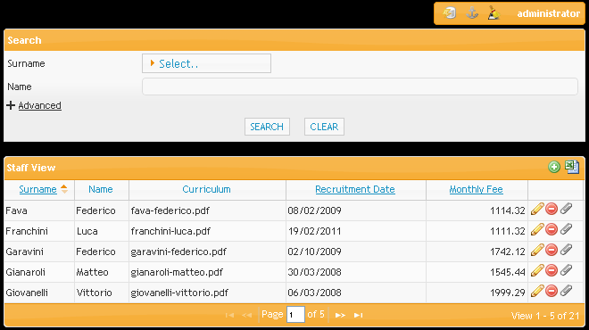
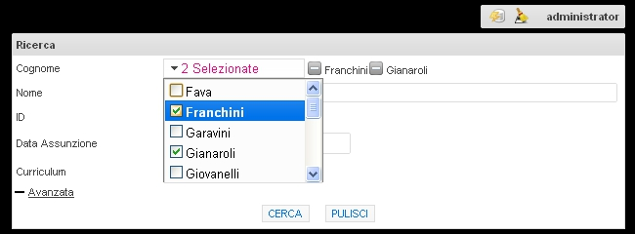
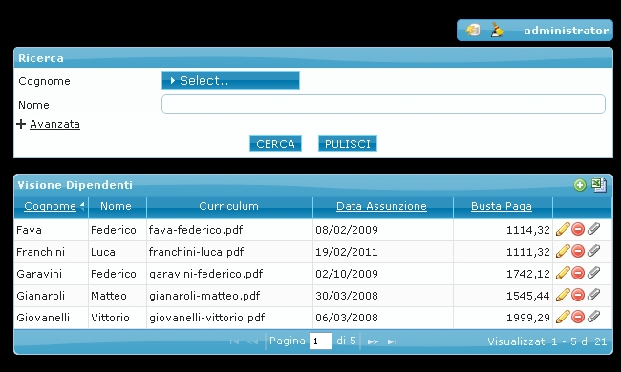
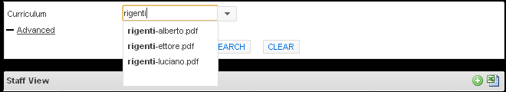








Check Box
DropDownList
Central
Authentication
Service
Is That All?!
SINGLE SIGN-ON (SSO)
Safety
Ajax Call
jQuery UI Themes
New Structures
Multi Language

Slide 7
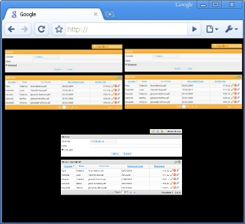
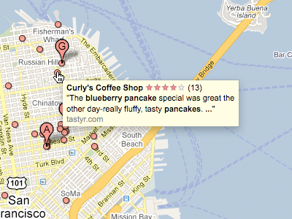
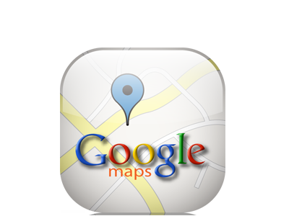

Coming Soon
One or More DataViev
Portal
Results in Google Maps
Cloud Architecture
VIEWER CLIENT
Information
Exchange
Charts
VIEWER SERVER
DATAVIEW SERVER

Slide 8
Tesi e Presentazione
grazie a tutti
per l’attenzione
http://www.dbgroup.unimo.it/tesi

